Slide 1
Project: Information Retrieval Models
An Overview of Fuzzy Set Theory, Extended Boolean, and Algebraic IR Models

Slide 2

Goal
To use different Models for efficient document retrieval.
Enhance understanding of core concepts in Information Retrieval.

Slide 3

Objective
Implement a Python-based Web based app to search Documents.
01
Handle user queries effectively with error tolerance.
02
Provide accurate document rankings based on query relevance.
03

Slide 4
Installation Guide
1. Clone the repository
2. Create a virtual environment and install dependencies
3. Run the server using: python manage.py runserver

Slide 5
Technologies Used
Python, Django
Core Data Structures (Dictionaries, Lists)
Algorithm Design (Custom TF-IDF Logic)

Slide 6
Core Features
1. File uploading and indexing
2. Keyword-based search with ranking
3. Stop word removal for efficient indexing

Slide 7
Code Explanation
1.Different model for indexing and ranking
2. Keyword matching for search results
3. Cosine similarity for ranking documents

Slide 8

Fuzzy Set Theory
Imagine regular search is like a light switch—it's either on (relevant) or off (not relevant).
With the fuzzy model, it's like a dimmer switch. It can be a little relevant, somewhat relevant, or very relevant.
Fuzzy set theory allows for degrees of membership rather than strict binary membership.
An element can have a partial or fuzzy membership in a set.

Slide 9

Fuzzy Set Theory in IR
Documents or queries can be associated with multiple degrees of relevance.
Instead of just being relevant or irrelevant, a document can be partially relevant to a query.
Fuzzy set-based IR models help address ambiguity and vagueness in retrieval tasks.
These models allow for a nuanced representation of relevance.

Slide 10

Extended Boolean Model
Regular search uses simple words like 'AND,' 'OR,' and 'NOT' to find things.
The extended Boolean model allows more specific queries like 'Fruits OR Vegetables BUT NOT Processed Food'.
It enhances the precision and flexibility of traditional Boolean search.

Slide 11

Generalized Vector Model
Documents and queries are represented as vectors in a multi-dimensional space.
Each dimension corresponds to a unique term or feature.
Documents and queries are like arrows in this space, with direction and length indicating relevance.

Slide 12

Algebraic IR Models: Latent Semantic Indexing (LSI)
Algebraic IR models, like LSI, go beyond simple word matching to understand semantic relationships.
LSI uses Singular Value Decomposition (SVD) to analyze relationships between terms in large corpora.
LSI discovers hidden semantic structures, retrieving conceptually related documents even without exact word matches.

Slide 13
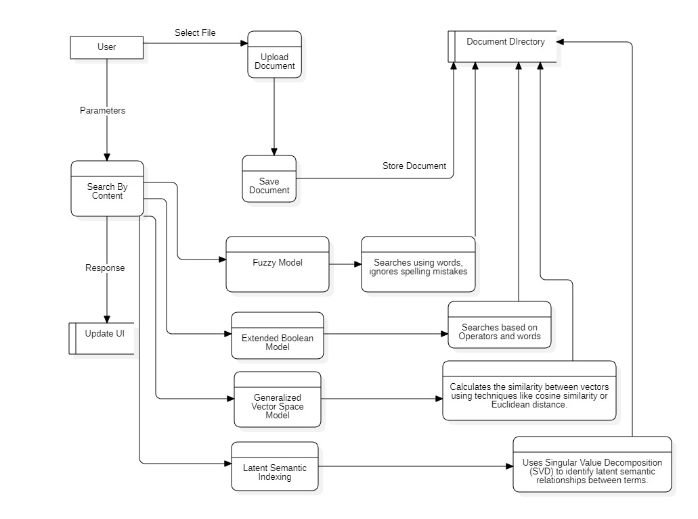
DFD

Slide 14
DFD Explanation
Upload Document: Stores files in the Document Directory.
Search By Content: Locates documents based on search queries.
Ranking: Ensures accurate search results based on different models.
Display Results: Shows ranked search results.

Slide 15
Future Enhancements
Add support for multiple document formats (PDF, Word, etc.)
Integrate NLP and semantic search capabilities
Optimize search algorithms for better accuracy

Slide 16
Thank You
Questions and Discussions Welcome!

